Slide 1
Digital Electronics
A gentle introduction!

Slide 2
What is Digital Electronics ?
Electric Circuits which operate on / with "digital" signals
Uses binary notation (1’s and 0’s) for data transmission
Circuits are made of logic gates

Slide 3
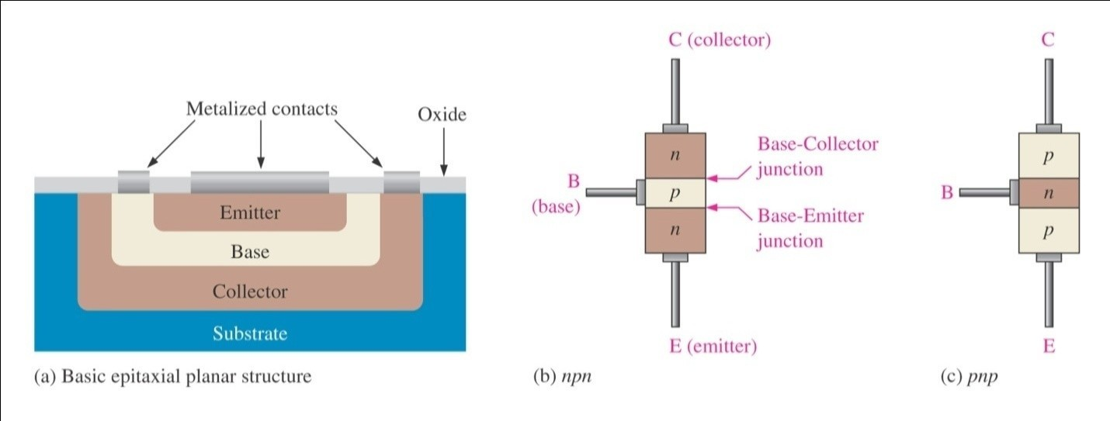
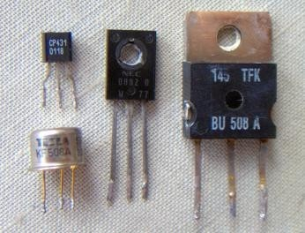
Basic Element: Transistor (switching mode)

Slide 4
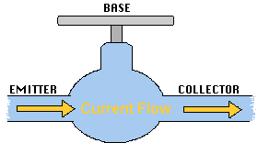
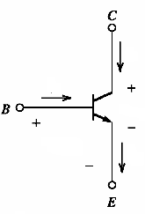
Transistor Mechanical Analogy
force – voltage/current water flow – current
- amplification

Slide 5
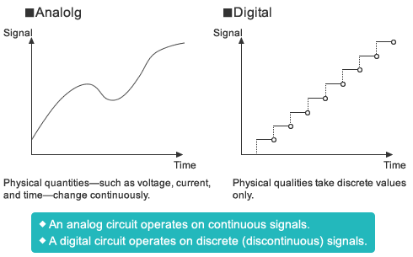
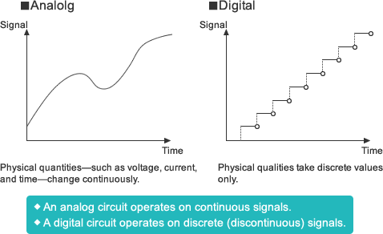
Analog and Digital: Comparison

Slide 6

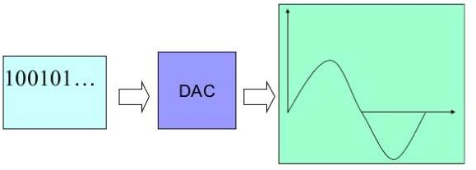
Analog ↔ Digital: Conversion
ADC converts real-world analog data to digital form.
DAC converts digital data to continuous form

Slide 7
Advantages of going Digital
Easy to design
Flexibility in programming
Immune to noise
High-speed designs possible
Transmission over long distances more secure

Slide 8
Disadvantages of going Digital
Higher design cost
Less Portability
Higher energy consumption
Real world needs A-D conversions
Quantization errors due to sampling

Slide 9
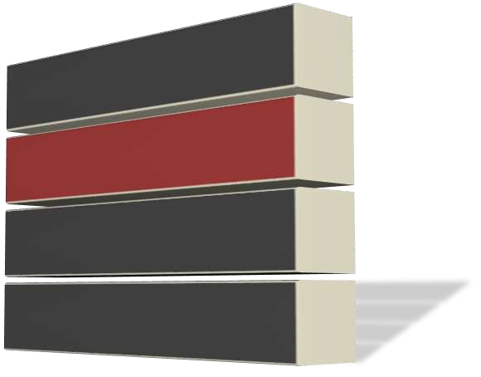





Number systems

Slide 10

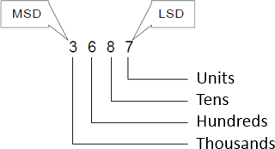
Decimal Number System
Uses 10 symbols / digits: 0,1,2,3,4,5,6,7,8,9
Base 10 (also called Decimal)
Natural number system for counting
for humans
Read as:
Three Thousand Six Hundred Eighty Seven
Decomposed as:

Slide 11
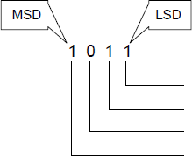

Binary Number System
Uses 2 symbols / digits: 0,1
Base 2 (also called Binary)
Natural number system for counting
for computers!
Read as:
One Zero One One
Decomposed as:

Slide 12
Hexadecimal Number System
Uses 16 symbols / digits: 0,1,2,3,4,5,6,7,8,9,A,B,C,D,E,F
Base 16 (also called Hexadecimal)
Natural system for expressing large numbers
Like memory addresses in computers!
Read as:
0x “One A Six D”
Decomposed as:
1 x 16³ + 10 x 16² + 6 x 16¹ + 13 x 160
= 4096 + 2560 + 96 + 13 = 6765 (decimal)
0x1A6D

Slide 13
Binary System Operations
Summation (add)
Subtraction (difference)
Multiplication
Division

Slide 14
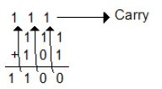
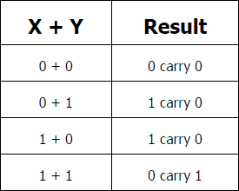


Binary Operation: Add

Slide 15
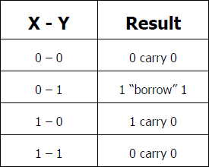



Binary Operation: Subtract
Borrow -> 111
10100
- 111
-----------------
01101

Slide 16
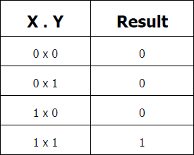
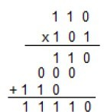

Binary Operation: Multiply

Slide 17
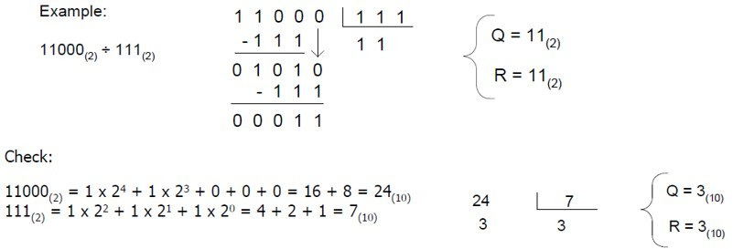
Binary Operation: Divide

Slide 18
logic Gates

Slide 19

NOT gate
Symbol | Truth Table
 | X | Z
 | 0 | 1
 | 1 | 0

Slide 20
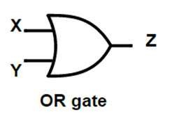
OR gate
Symbol | Truth Table
 | X | Y | Z
 | 0 | 0 | 0
 | 0 | 1 | 1
 | 1 | 0 | 1
 | 1 | 1 | 1

Slide 21
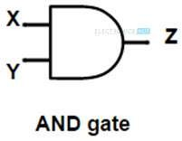
AND gate
Symbol | Truth Table
 | X | Y | Z
 | 0 | 0 | 0
 | 0 | 1 | 0
 | 1 | 0 | 0
 | 1 | 1 | 1

Slide 22


NAND gate (UNIVERSAL)
Symbol | Truth Table
2-input NAND Gate | A | B | Q
 | 0 | 0 | 1
 | 0 | 1 | 1
 | 1 | 0 | 1
 | 1 | 1 | 0

Slide 23

NOR gate
Symbol | Truth Table
2-input NOR Gate | A | B | Q
 | 0 | 0 | 1
 | 0 | 1 | 0
 | 1 | 0 | 0
 | 1 | 1 | 0

Slide 24

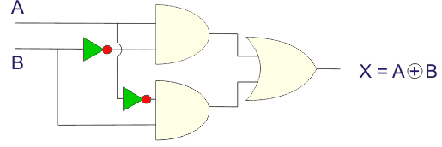
XOR gate
Symbol | Truth Table
2-input XOR Gate | A | B | Q
 | 0 | 0 | 0
 | 0 | 1 | 1
 | 1 | 0 | 1
 | 1 | 1 | 0

Slide 25
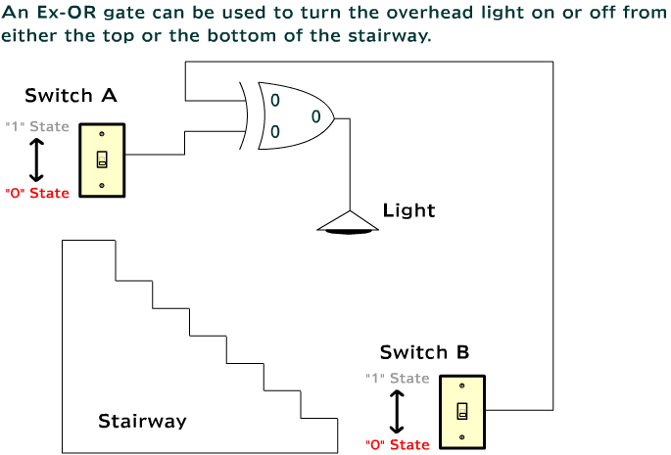
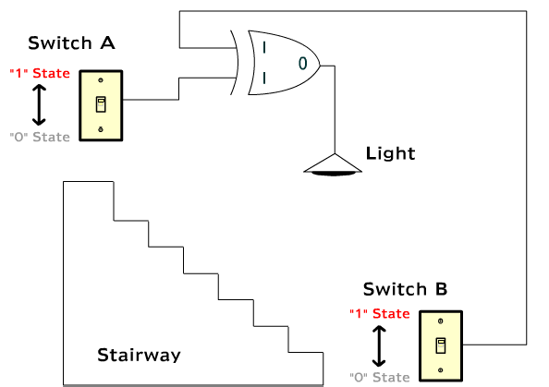
Ex-OR / XOR gate: Insight

Slide 26
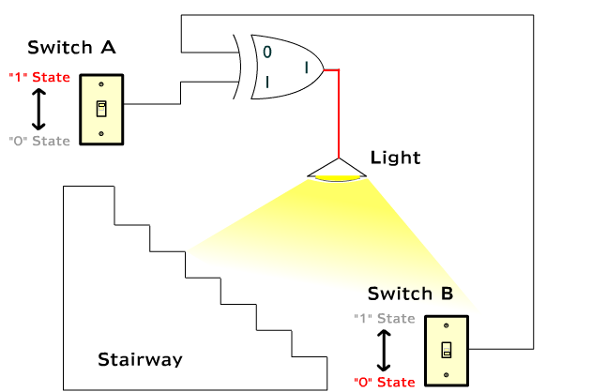
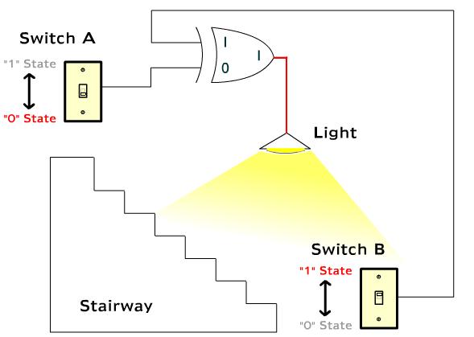
Ex-OR / XOR gate: Insight

Slide 27
Combinational Logic
Output depends
only on current inputs
Previous inputs do not have any effect
We call it memoryless system
Examples:
All logic gates studied so far
NOT gate
OR gate
AND gate
NAND gate
NOR gate
XOR gate

Slide 28
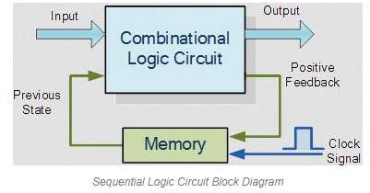
Sequential Logic
Output depends
not only on current inputs but also on past sequence of inputs
We say it possesses memory
Output depends on a sequence of events occurring at inputs
Examples: Latch, Flip-Flop

Slide 29
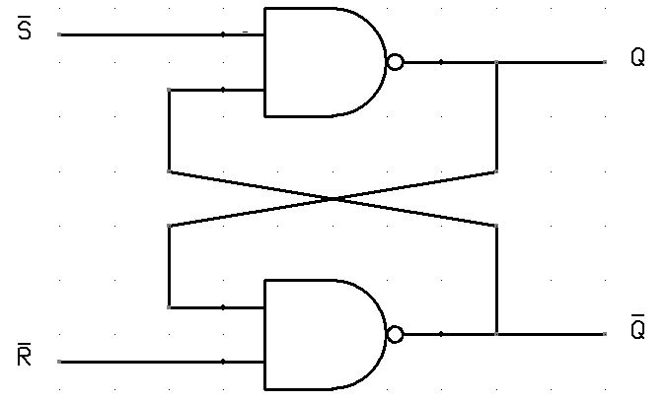
Latch Example: SR
Set Reset (SR) Latch
R==1 ‘resets’ Q, S==1 ‘sets’ Q
S==R==1 is invalid
No clock / synchronization
Remember for NAND
1,1 gives 0
All others give 1
S | R | S’ | R’ | Q | Q’
0 | 0 | 1 | 1 | Q_{prev} | Q’_{prev}
0 | 1 | 1 | 0 | 0 | 1
1 | 0 | 0 | 1 | 1 | 0
1 | 1 | 0 | 0 | Inv | Inv

Slide 30
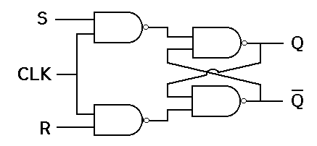
Flip Flop Example: SR
Set Reset (SR) Flip Flop
notice the CLK
S==1 ‘sets’, R==1 ‘resets’
But only when CLK is high
CLK | S | R | Q | Q’
↑ » 1, ↓ » 0 | 0 | 0 | 0 | 1
↑ » 1, ↓ » 0 | 0 | 1 | 0 | 1
↑ » 1, ↓ » 0 | 1 | 0 | 1 | 0
↑ » 1, ↓ » 0 | 1 | 1 | X | X

Slide 31
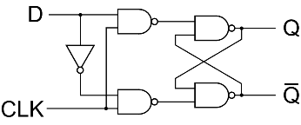
Flip Flop Example: D
D Flip Flop
notice the CLK
“Delays” the signal through CLK
CLK | D | Q | Q’
↓ » 0 | 0 | 0 | 1
↑ » 1 | 0 | 0 | 1
↓ » 0 | 1 | 0 | 1
↑ » 1 | 1 | 1 | 0

Slide 32
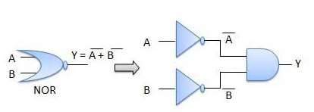
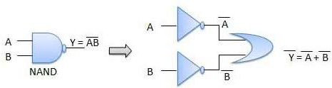

Boolean Algebra
Mathematics / Algebra of Digital Signals
Limited operations possible:
OR (X + Y)
AND (X . Y)
NOT (~ X)
DeMorgan’s Laws help in simplification

Slide 33
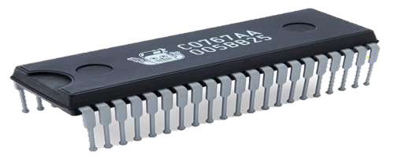

Integrated Circuit (IC)
A set of electronic circuits on one small flat piece (or "chip") of semiconductor material, normally silicon.

Slide 34
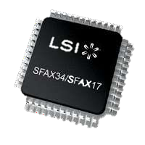
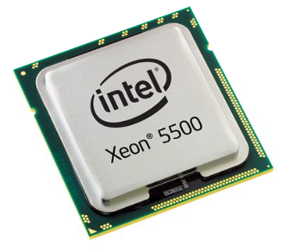

ICs: Classification
Acronym | Expanded form | Year | # of transistors | # of logic gates
SSI | small-scale integration | 1964 | 1 to 10 | 1 to 12
MSI | medium-scale integration | 1968 | 10 to 500 | 13 to 99
LSI | large-scale integration | 1971 | 500 to 20,000 | 100 to 9,999
VLSI | very large-scale integration | 1980 | 20,000 to 1,000,000 | 10,000 to 99,999
ULSI | ultra-large-scale integration | 1984 | 1,000,000 and more | 100,000 and more

Slide 35
IC Families
Family refers to the type of elements / devices used for creating the Digital Circuit
There are several IC Families:
TTL (Transistor-Transistor Logic)
CMOS (Complementary Metal Oxide Semiconductor)
ECL (Emitter-Collector Logic)
etc.
Each Family has its own properties and parameters
These play a big role in selecting a Family for an Application

Slide 36
IC Family Parameters
Power Supply Voltage
Operating Temperature
Minimum, Maximum
Propagation Time
Noise Immunity
Power Dissipation
Fan-in
Fan-out

Slide 37
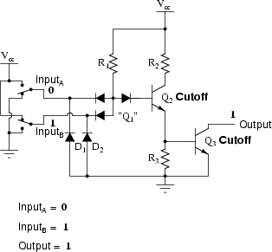
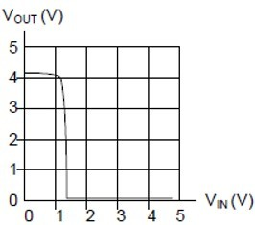
IC Family: TTL
Supply Voltage
4.5 – 5.5 V
Operating Temperature
0 – 70ºC
Transition zone
1 – 1.5V
Propagation Time
10 nsec
Power Dissipation
~10mW/gate

Slide 38
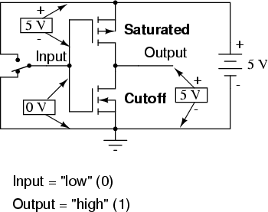
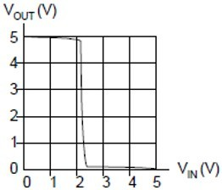
IC Family: CMOS
Supply Voltage
Variable, 3 – 15 V
Operating Temperature
0 – 85ºC
Transition zone
2.25 – 2.75V (noise immunity)
Propagation Time
125 nsec (5V), 45nsec (15V)
Power Dissipation
~10nW/gate

Slide 39
Thank you!

